Slide 1
AIR POLLUTION MONITORING AND ALERT SYSTEM PAVAN
GUIDED BY,
PROF. KALPANA
DEPARTMENT OF INFORMATION TECHNOLOGY
AGILAN S 15EUIT003
FAHEEN FATHIMA B N 15EUIT030
HARISH RAJ 15EUIT036
HINDU SREENI 15EUIT040
KARTHIK U 15EUIT048

Slide 2
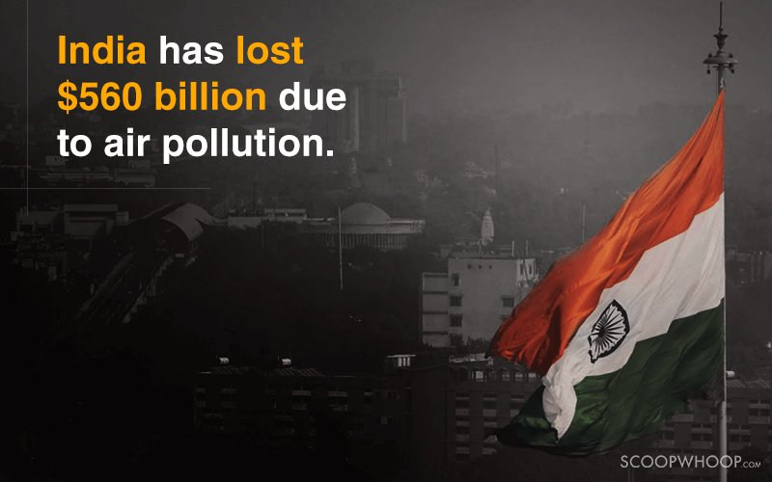
INTODUCTION
There are several problems that the mother earth faces, among which pollution is the most deadly and attention grasping problem. Air pollution has been regarded as THE FIFTH LARGEST KILLER IN INDIA. Moreover, air pollution poses a major threat to the very existence of people in the country’s capital. In order to provide proper information and alert the people in an area, a central monitoring system is required which detects the pollutants

Slide 3
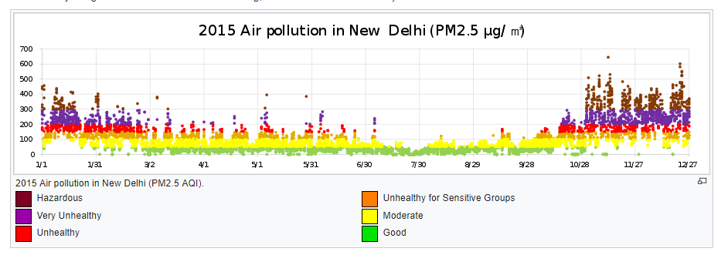
PROBLEM STATEMENT
Increase in pollution in recent years by manifold
Unawareness of the growing impact on pollution by the people
Increase in several pollutants level in air
Lack of monitoring system in localities where pollution is increasing
Lack of cheap integrated system to alert people of the increasing toxic level in air.

Slide 4
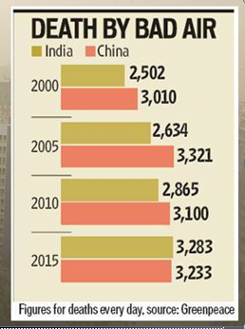
OBJECTIVE OF THE PROJECT
The development of PAVAN – an integrated air pollution monitoring and alert system . The objective of our project involves in creating awareness to the public about the increase in toxic level in air and warn them about the sources of the air pollution.
PAVAN senses the pollutants and toxic level in air providing statistics about the current pollution level in that area.

Slide 5
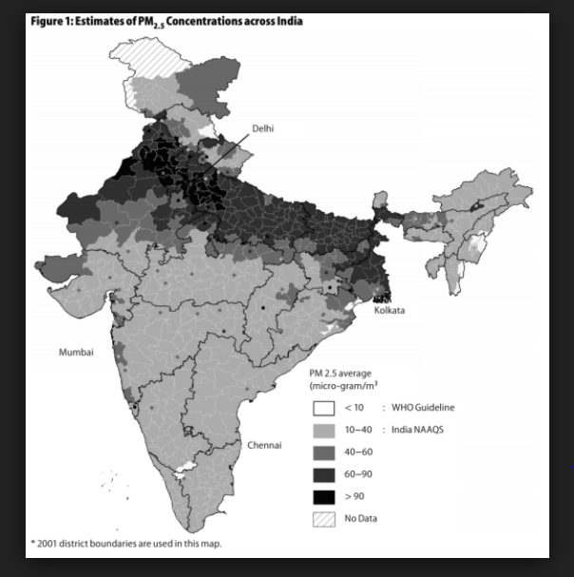
SCOPE OF THE PROJECT
Pollution prevails to be a life-threatening problem that the whole world faces and hence it becomes a priority where every one has to be aware of the growing danger in the locality. Thus, the scope of PAVAN lies over all parts of the world.
PAVAN becomes an integrated system where the measure of pollutant levels can be identified uniquely for each pollutant and can be improved over the effects of toxicity it causes. Moreover, it can provide a statistical report of the toxicity in air and the vulnerability of the locality to pollution.

Slide 6
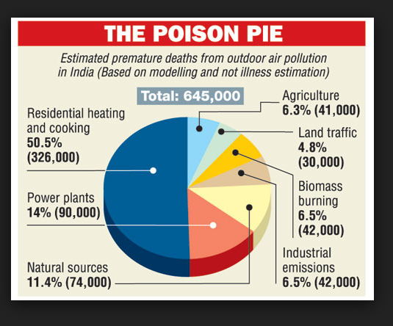
LITERATURE SURVEY
Outdoor pollution has risen 8% in five years with fast-growing cities in the developing world worst affected, WHO data shows
”In May 2014, New Delhi was regarded as the world’s most polluted city in the world”.
About 4000 schools were closed for nearly a week due to air pollution.

Slide 7
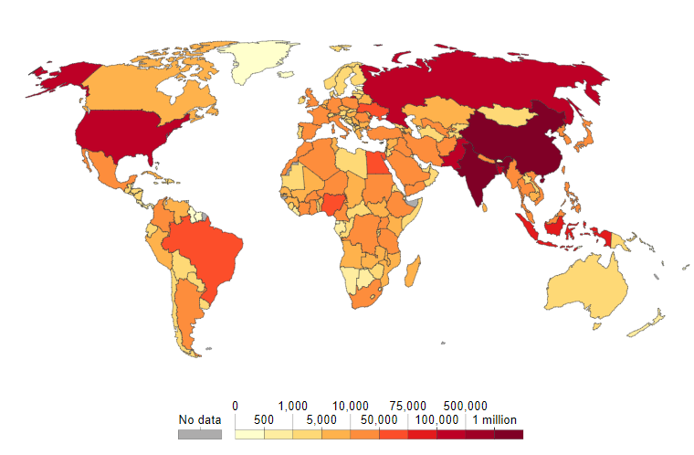
DEATHS BY AIR POLLUTION

Slide 8
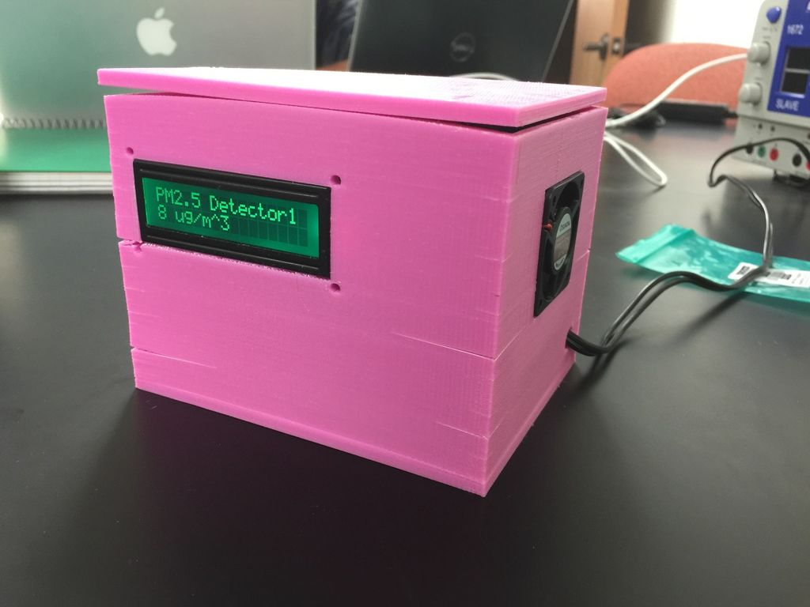
EXISTING SYSTEM
“Wireless sensor network based pollution monitoring system in metropolitan cities”,Shwetal Raipure, Deepak Mehetre. IEEE ICCSP2015 conference
“IOT-based Air Pollution Monitoring and Forecasting system”, Chen Xiaojun,Liu Xianpeng,Xu Peng, International Conference on Computer and Computational Sciences (ICCCS) 2015

Slide 9
PROPOSED SYSTEM
Introducing PAVAN which is the combination of software and hardware that is used for sensing, processing and alerting the environment about the toxicity levels present in the air
Providing the data about the total pollutants and its sources for normal people.
Detecting the toxicity level in air and finding measures in reducing the total pollution in air.
Alerting the environmentalists about the rising dangers of air pollution.

Slide 10
REQUIREMENTS
HARDWARE REQUIREMENTS:
Arduino uno
MQ-9
MQ-135
DUST SENSOR
SOFTWARE REQUIREMENTS:
Arduino IDE
Visual basics

Slide 11
EXPECTED OUTCOME
Integrated software and hardware system
Statistical data of the pollution level
Sources of the pollutant data
Awareness of the toxicity in air
Prevention of further hazards in air
Managing and maintenance of pollution activity over an area.

Slide 12
CONCLUSION
Thus PAVAN provides user friendly approach towards the environmental education. It can clearly detect and alert the sudden rise in toxic level of air with proper measures and guidelines. Thus PAVAN proves to be an intelligent approach towards the protection and prevention of air pollution hazards met in the future.

Slide 13
THANK YOU!

